Slide 1

Hybrid CNN-Transformer Deep Reinforcement Learning Agent for Cryptocurrency Trading
Boulionis Athanasios – AI 189

Slide 2
Introduction
This project explores the design and evaluation of a hybrid reinforcement learning agent for cryptocurrency trading.
Causal 1-D CNN:
Unsupervised front-end
Extracts short-term patterns and micro-trends
Reduces input noise
Transformer Encoder:
Backbone of the agent
Uses self-attention for modeling long-term dependencies
Captures trends and market momentum
Transformer receives both raw time-series data and CNN-extracted features, producing a denser, noise-filtered market representation.

Slide 3
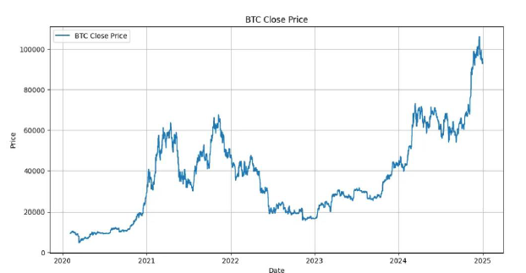
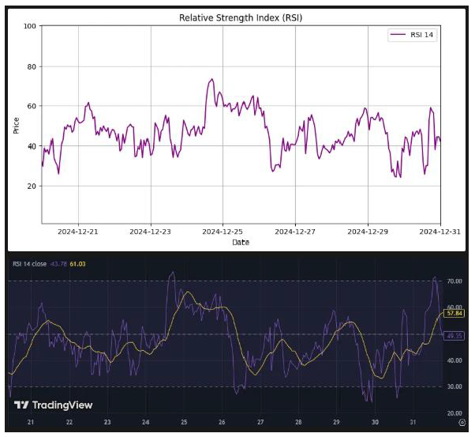
Data Collection
Data Sources:
Raw candlestick data (OHLCV) from Binance API
Technical indicators (RSI, MACD, EMAs, etc.)
Multi-timeframe inputs: 1-hour & 1-day
Collection & Processing:
Automated scraping and indicator calculation
Flexible indicator configuration (YAML)

Slide 4
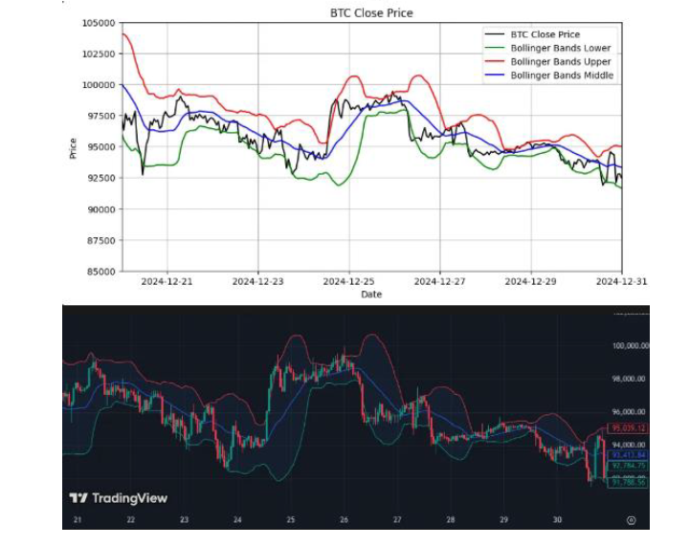
Data Collection
Dataset Details:
Coverage: Late 2020–2024 (bull, bear, sideways, uptrend phases)
Split into intervals of 5,000 timesteps: 4,000 for training, 1,000 for validation
Reduces bias across different market regimes

Slide 5
Trading Environment
The environment is based on the Gymnasium interface.
Key components:
Action Space:
4 Discrete action space:
Do nothing
Increase position
Decrease position
Close position
Reward Function:
Reflects realized profit & loss, normalized by initial account balance
Updated to also consider unrealized PnL
Observation Space:
Rolling 1-week window (168 hours)
76 features × 168 timesteps
74 static features (day, hour, OHLCV, indicators)
2 dynamic features (balance, unrealized PnL)
The environment simulates key exchange mechanics, such as bid/ask spread, trading fees, liquidation, trading constraints etc.

Slide 6
Training & Evaluation
Episode Setup:
Episodes start at random points within training/test intervals
Each episode lasts up to 2 weeks (336 timesteps) or ends early upon liquidation
After each episode, the environment resets with a new random starting point
Enhancements for Realism:
Recent Data Prioritization:
More frequent sampling of recent timesteps to focus on current market conditions
Randomized Starting States:
Agent may start with open long or short positions; probability of starting with unfavorable conditions increases over training

Slide 7
Proximal Policy Optimization (PPO)
Actor (Policy Network):
Selects actions based on the current observation
Aims to maximize cumulative reward
Critic (Value Network):
Estimates the value of the current state
Evaluates the advantage of each action taken by the actor

Slide 8
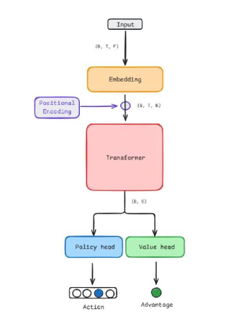
Transformer-Only Training
Custom Transformer backbone built with PyTorch and Ray
Model Components:
Input Processing:
Raw observations are embedded and enriched with positional encodings
Output Heads:
Dynamic features (wallet balance, unrealized PnL) extracted from the latest timestep
These are combined with the transformer's output
Fed into two separate, identical networks for policy (actor) and value (critic):
Linear (embed_size+2 → 256) → LayerNorm → GELU → Linear (256 → action_space_size)
Transformer Model:
Multiple encoder layers with multi-head self-attention
Includes normalization, dropout, and GELU activation

Slide 9
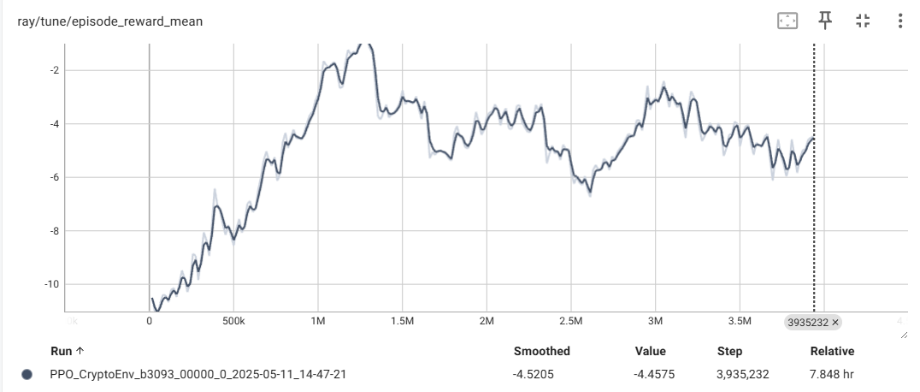
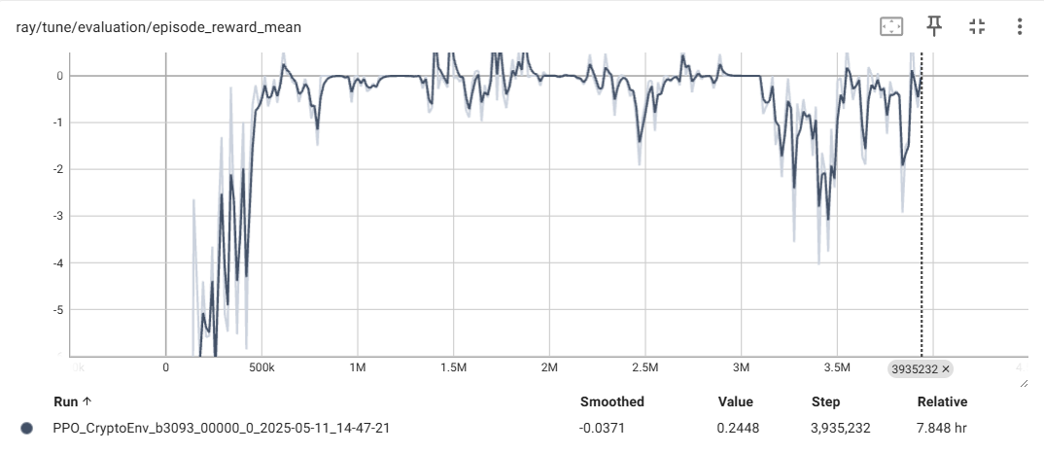
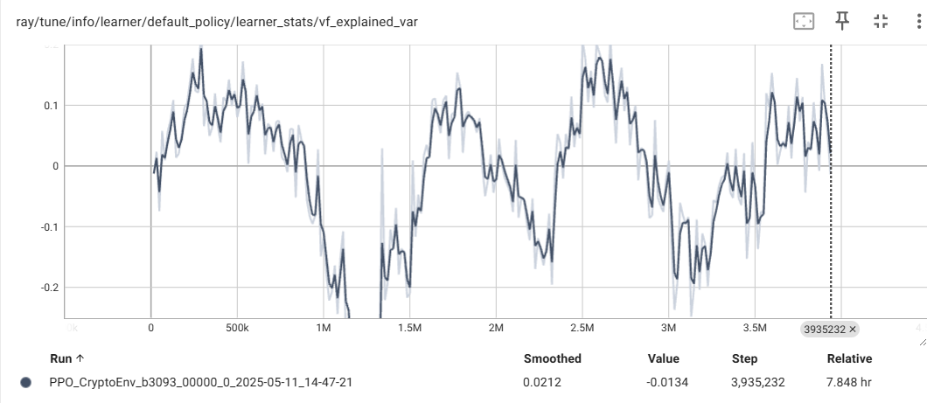
Training Process & Results
Training Overview:
17 total training runs
Total compute time: ~ 268 hours
TensorBoard metrics available in tensorboard_screenshots/
Run #13:
Hyperparameter Tuning:
Adjusted PPO settings: learning rate, entropy/kl coefficients, parameter & gradient clipping
Modified Transformer, Actor, and Critic heads: depth, width, normalization, and dropout layers
Notes:
Run #13 showed the most promising results
Some signs of policy learning, but stability remains a challenge
Plan: Resume from best checkpoints for further fine-tuning

Slide 10
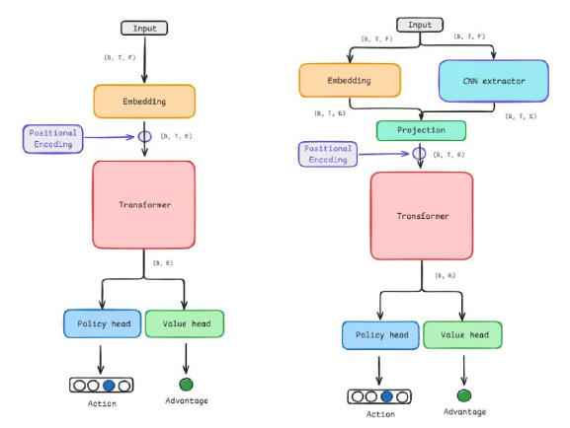
CNN Front-End Implementation
Role:
1-D causal CNN acts as a feature extractor before the transformer
Captures local, short-term patterns from each 168-hour window
Architecture:
CNN processes the raw input, producing a compact feature map
CNN output is concatenated with input embeddings
Combined vector is compressed back to embed_size
Positional encoding
Notes:
Input: PyTorch expects (batch_size, input_size=72, sequence_length=168)
1 Filter (Kernel): A single filter has shape (kernel_size=3, input_size=72) → Weights: (3, 72)
This kernel slides over the time axis and computes a single scalar by multiplying the values of all the features x 3 → Output (1, 168)

Slide 11
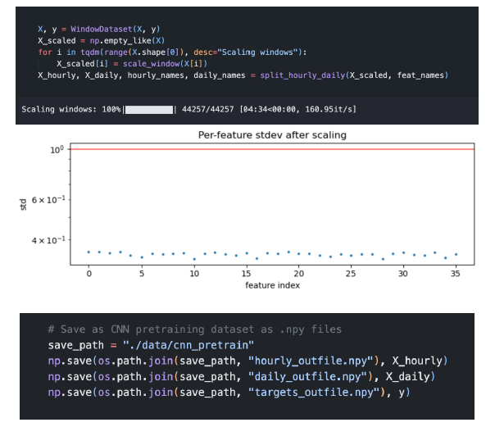
CNN Pre-Training Data
Pre-train the CNN feature extractor on data formatted identically to the RL environment’s observations.
Data Preparation:
Original dataset converted into sliding windows
Each window scaled independently
Data separated into hourly and daily segments
Challenges:
Early experiments faced issues with data leakage and scaling errors

Slide 12
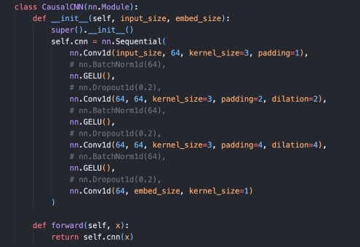
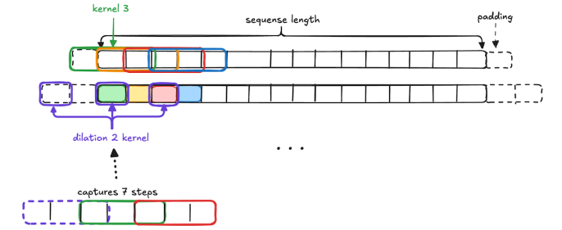
Causal CNN Architecture
Network Structure:
4 stacked 1-D convolutional layers
Each layer: 64 kernels, kernel size 3
Uses padding and dilation to expand receptive field efficiently
Pipeline:
Input: (batch size, features, seq_length)
CNN output: (batch size, embed_size, seq_length)
Max pooling: (batch size, embed_size)
Classification head: single hidden layer → output (batch size, 2)
Notes:
Use padding to preserve sequence length
Employs increasing dilation (1 → 2 → 4)
Expands receptive field to 15 steps efficiently
Each kernel overlaps previous representations for context

Slide 13
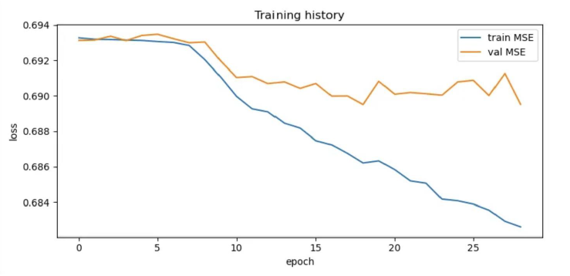
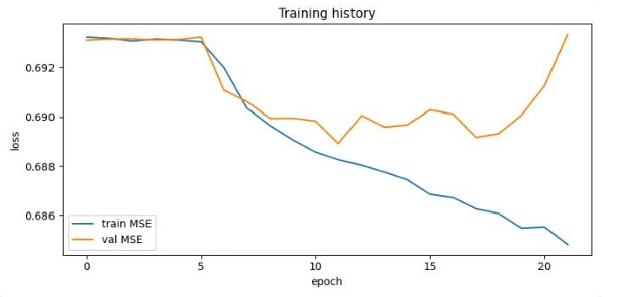
CNN Pre-training
Best Validation Balanced Accuracy: 52.84%
Experimentation Highlights:
Tested various learning rates and batch sizes
Tried batch normalization, dropout, and weight decay
Added extra convolutional layers (with higher dilation/padding)
Added hidden layers to classification head and used label smoothing
Results:
Training remained difficult and unstable despite extensive tuning

Slide 14
CNN Integration
Pipeline Options:
Switch CNN feature extractor on/off
Freeze/unfreeze CNN parameters during RL training
Architecture Adjustments:
CNN now processes only the hourly data (daily features excluded for simplicity/time constraints)
Extracted CNN features are concatenated with raw input embeddings
Combined vector is projected to embed_size for transformer compatibility
Current configuration:
Pre-trained parameters were not loaded
CNN parameters un-frozen, the CNN module was trained together with the rest of the model

Slide 15
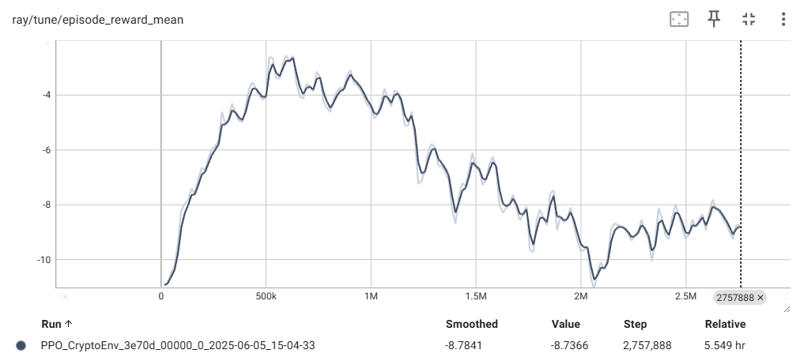
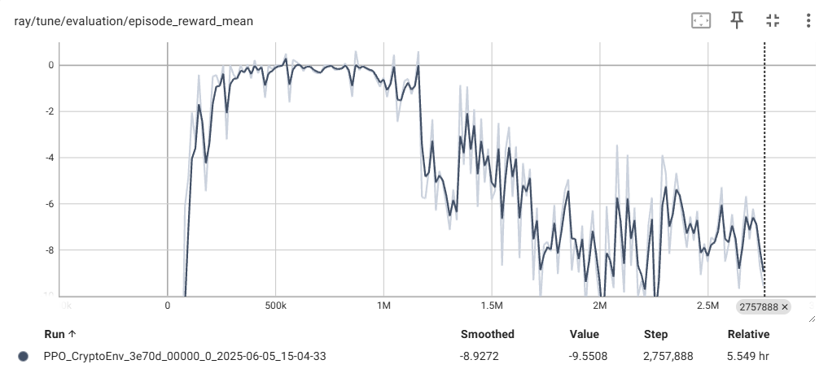
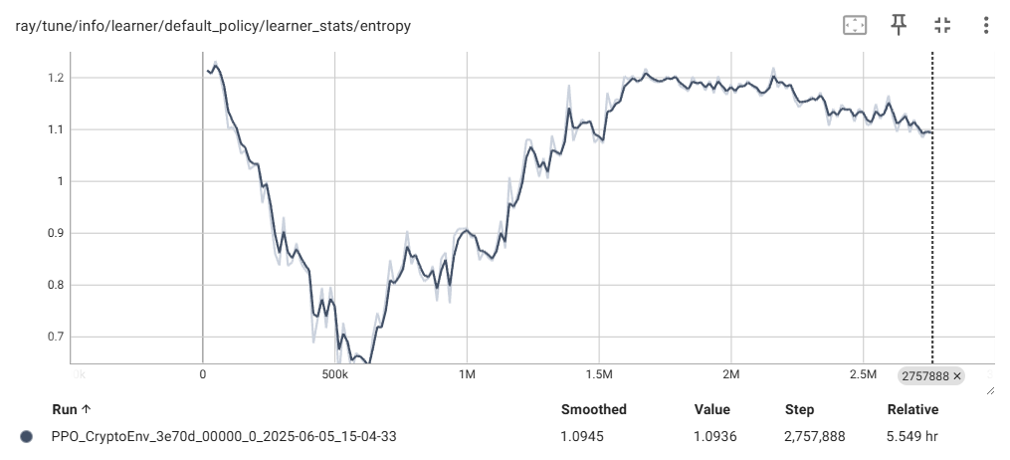
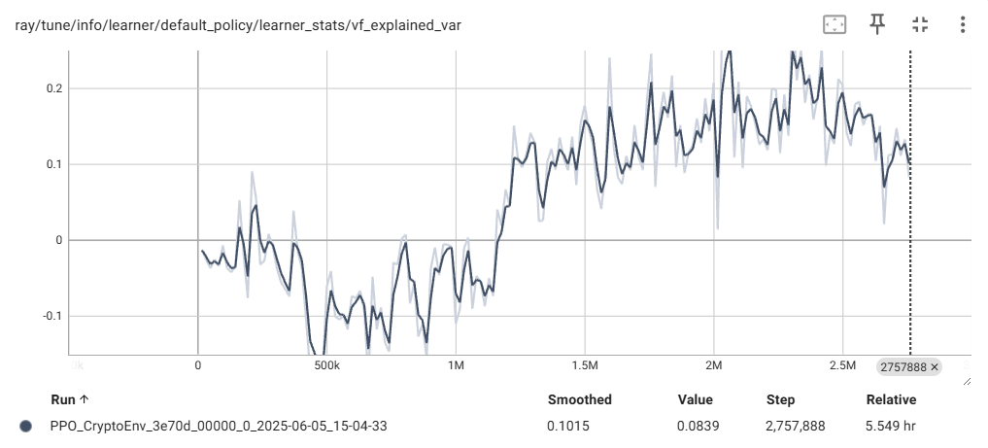
Final Run #1
Adding the CNN front-end led to a sharp initial increase in mean training reward
On validation, the agent quickly converges to a “do nothing” policy
Value function explained variance is improved and remains positive
When explained variance turns positive, mean reward begins to drop
Entropy drops sharply at first, then rises. Agent rapidly exploits “do nothing” policy for early reward, then diverges to search for better strategies

Slide 16
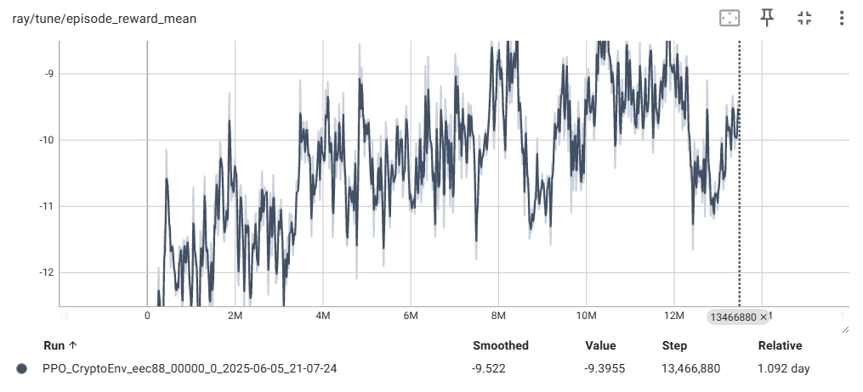
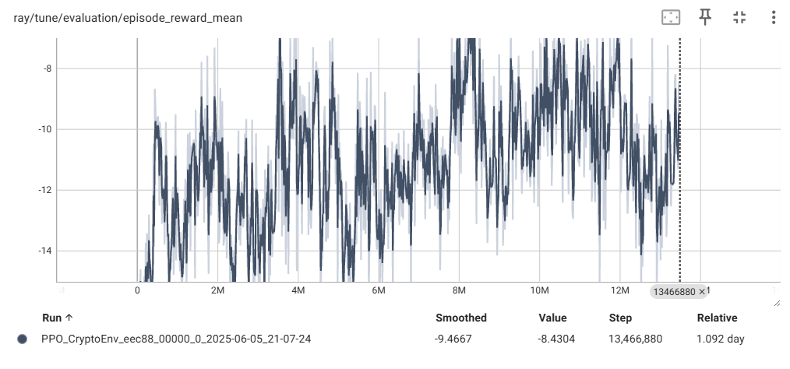
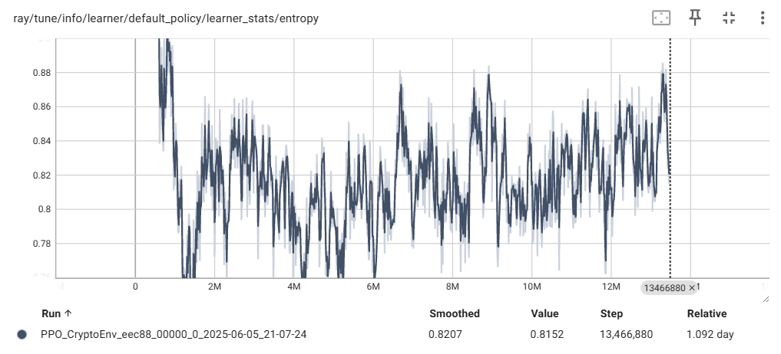
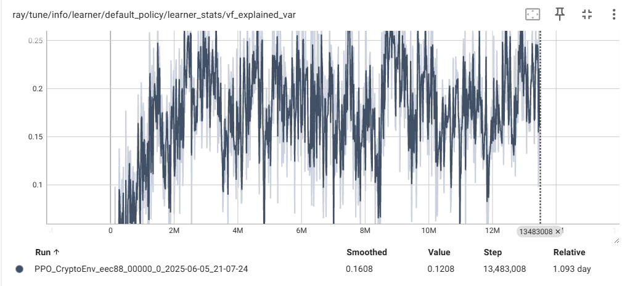
Final Run #2
Modified action space:
Do nothing
Close any open position & open a long position
Close any open position & open a short position
Prevents agent from staying out of the market.
Outcome:
Agent is now forced to seek profitable trades
Training became more challenging, with increased instability
Further experimentation with this action space is recommended

Slide 17

Thank you

